Slide 1
REAL ESTATE AGENT SAFETY
Presented by Tracey Hawkins
“Tracey, the Safety Lady”

Slide 2
Who is “Tracey, the Safety Lady”?
I have:
Been a real estate agent
Worked in the safety and security field over 20 years
Trained thousands of agents to work safely (over 1,100 in May 2015)
Spoken all over the country; from ND to TX, to NJ to CA
Worked with the National Association of REALTORS® on the safety initiative
Owner of Linked In’s Real Estate Agent Safety Forum group (over 3,000 members)
Nationally recognized safety and security expert
Research safety and security products and services
Offer tried and true safety and security products to agents
I am passionate about what I do!

Slide 3
Risks
Understand the risks in this business
You make a living meeting complete strangers in empty houses and sitting in empty houses waiting for strangers to come in.

Slide 4
Criminals
What does a criminal look like?

Slide 6
C I T O
Come
Into
The
Office

Slide 7
FaceTime/Skype CITO

Slide 8
Come Into Any Office
REALTORSafeHarbor.com
- Allows agents to find registered Safe Harbor locations that will allow agents to use their office to meet new clients, will provide the REALTOR client prospect form, and will scan/fax the form and ID of the client to the agent free of charge.

Slide 9
Collect information
NAR Forms
Go to realtor.org and search “Tracey Hawkins”
Forms allow your whereabouts to be known, your broker/manager to have key information about you and you to gather information from clients.

Slide 10
Cell Phone Safety
Accessibility
I.C.E.
Hack-proofing
Apps

Slide 11
Dressing Safely
What not to wear…

Slide 12
Making Safety Profitable and Worthwhile

Slide 13
Protect Your Sellers
“Client Safety Plan”

Slide 14
Seller Listing Safety
Security walk-through:
- Photos
Jewelry
Prescription meds
Mail
Lights, locks and landscaping
Buyers and agents who show up

Slide 15
DEA Announces 10th National Prescription Drug Take-Back
JUL 28 (NEWARK, N.J.) –– DEA Acting Administrator Chuck Rosenberg today announced that the 10th National Prescription Drug Take-Back will take place September 26th from 10 am-2 pm. As with the previous nine Take-Back events, sites will be set up throughout communities nationwide so local residents can return their unused, unwanted, or expired prescription drugs for safe disposal.

Slide 16
Safe Showing Techniques

Slide 17
Real Estate Agents and Pictures
Why inappropriate photos can make you a target.

Slide 18
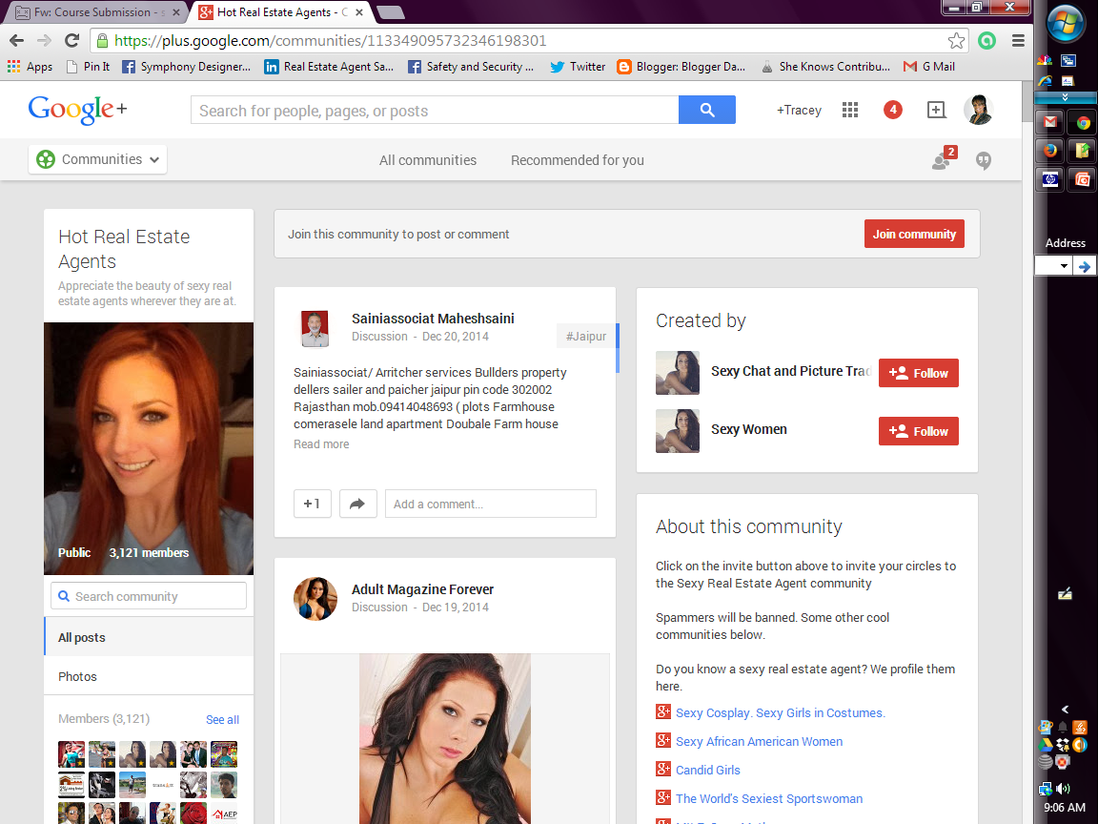

Slide 19
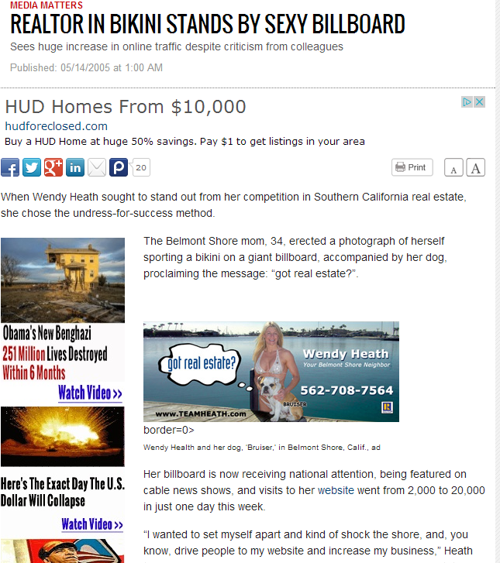

Slide 21
Real Estate Agent Photos

Slide 22
Agent Photos

Slide 23
Words to Avoid in Advertising

Slide 24
Words to Avoid
Isolated
Romantic
Private
Empty
Move-in immediately

Slide 25
Sellers and Photos

Slide 26
Open House Safety

Slide 27
Open House Safety
Fair Housing Discrimination Act
Seller Preparation- Security walk-through
Exits and parking
Emergency contact plan
Agent’s valuables
Enlist a partner

Slide 28
Smile You Are On Camera
Open House Video Monitoring:
https://www.realagentguard.com/opn-house-video-monitoring -

Slide 29
Why Being Nice to FSBOs Can be Good For Business and Help You Be a Good Neighbor

Slide 30
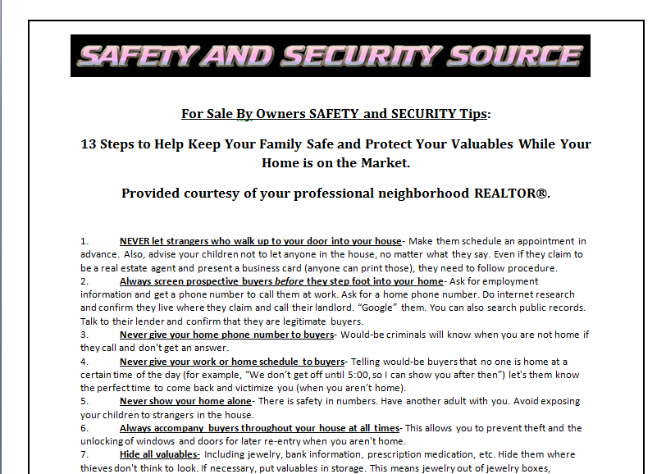
Why FSBO Safety is Your Business

Slide 31
E-Mail Me to Request FSBO Safety Tips
safetyandsecuritysource@gmail.com

Slide 32
RETAIL REAL ESTATE vs. DISTRESSED PROPERTIES
Pristine shape
Animals corralled
Family home
Friendly neighbors
Neighborhood watch to keep drugs and criminals out
Distressed condition
Abandoned, aggressive (or dead) pets/animals left behind
Possibly occupied by criminals and gang members
Angry neighbors
Drug houses/headquarters

Slide 33
SPECIFIC DANGERS
Mold
Methamphetamine labs
Abandoned, aggressive animals
Dead, contaminated animal carcasses

Slide 34
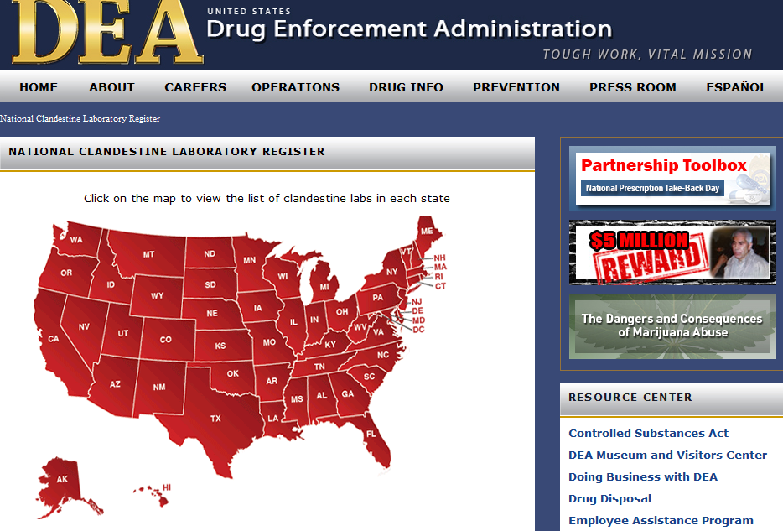
National Clandestine Laboratory

Slide 36
DEA’s National Clandestine Laboratory
Google it!

Slide 37
NAR Distressed Property Safety Webinar

Slide 38
SOCIAL MEDIA AND SMARTPHONE SAFETY FOR REAL ESTATE AGENTS
Notes:
Today we will cover how to use social media in a safe manner.

Slide 39
Phishing
E-mail sent
Looks like it came from familiar agent
Seeks to get agent to divert wired funds
PREVENTION
Don’t click on links in suspicious e-mails
Follow partner’s lead with encrypted e-mails
Report any suspicious activity

Slide 40
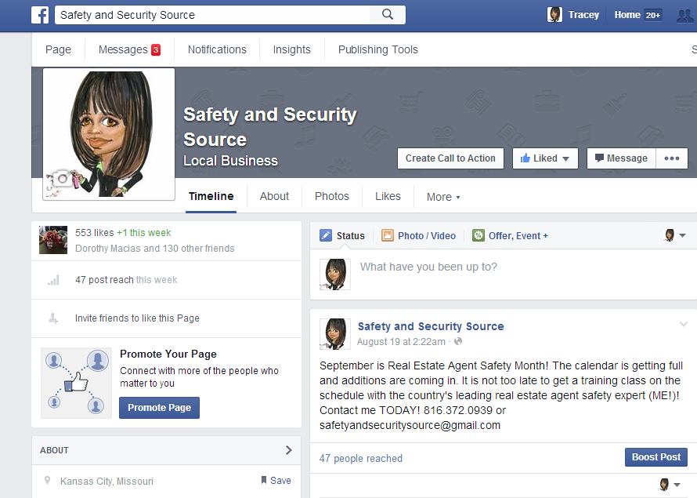
FaceBook Business Page

Slide 41
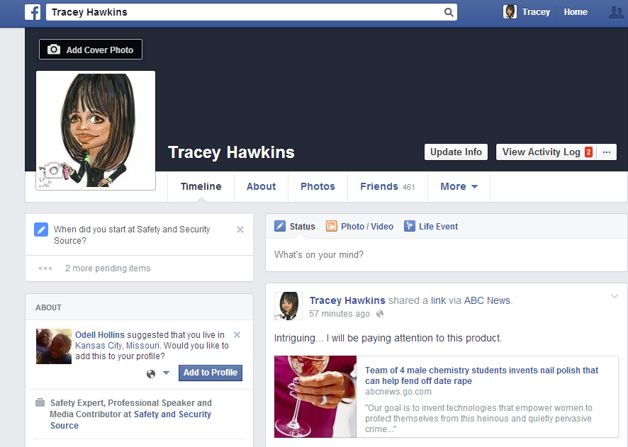
FaceBook Personal Page

Slide 42
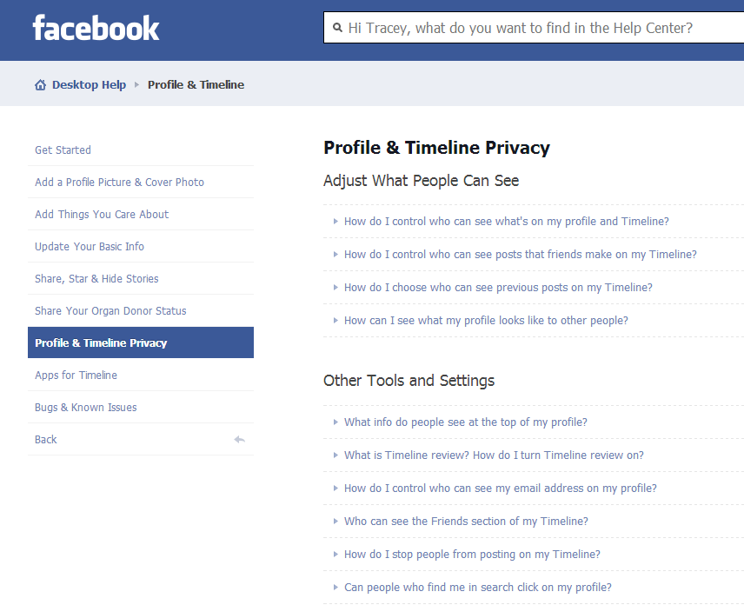
FaceBook Privacy Settings

Slide 43
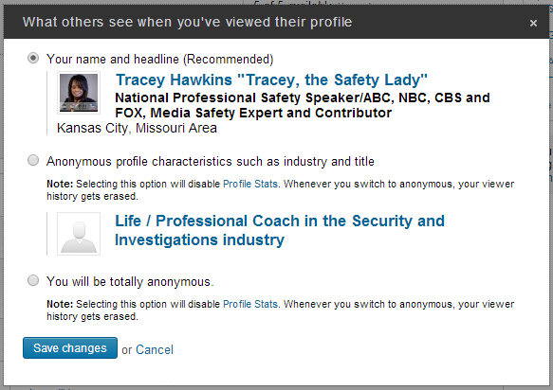
Linked In Profile Information

Slide 44
What Not to Say Online
Don’t Discuss:
- Sellers or Buyers on a blog or social media post
- Vacation plans
- Or brag about new possessions
- Open houses or your schedule

Slide 45
Websites that prove there is no such thing as privacy!

Slide 46
Websites that share personal information
Spokeo.com
Pipl.com
Peepyou.com

Slide 47
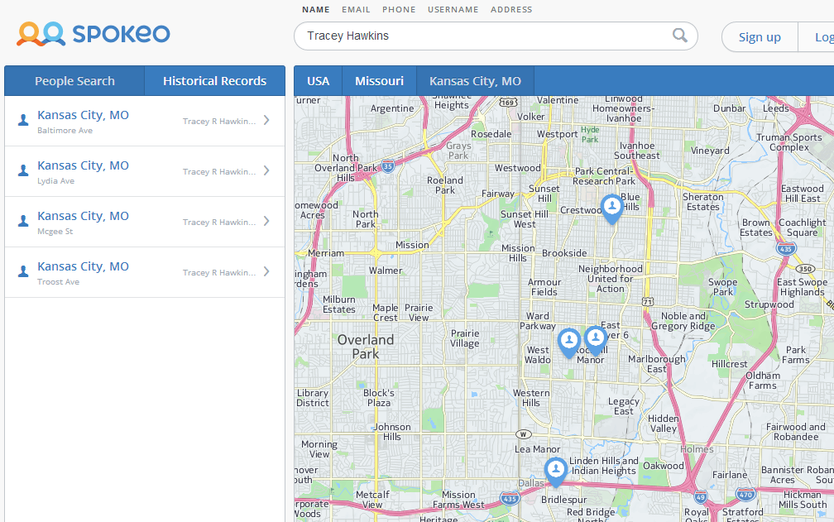
Spokeo.com Name Search

Slide 48
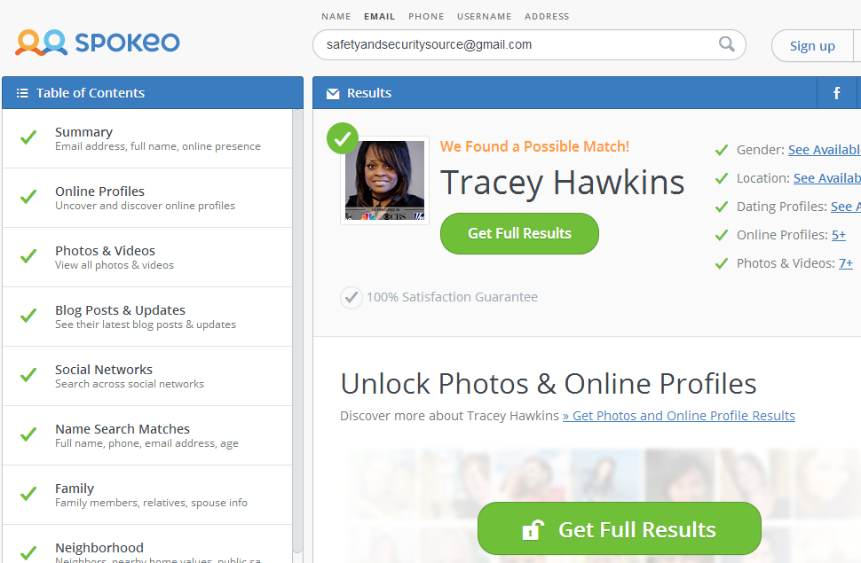
Spokeo.com E-mail search

Slide 49
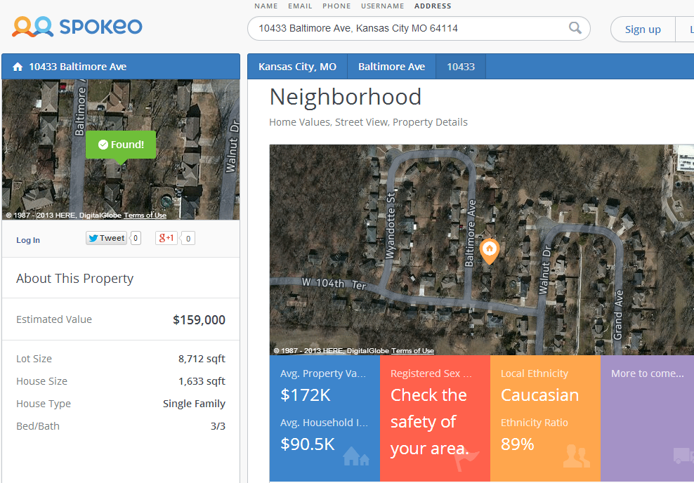
Spokeo.com

Slide 50
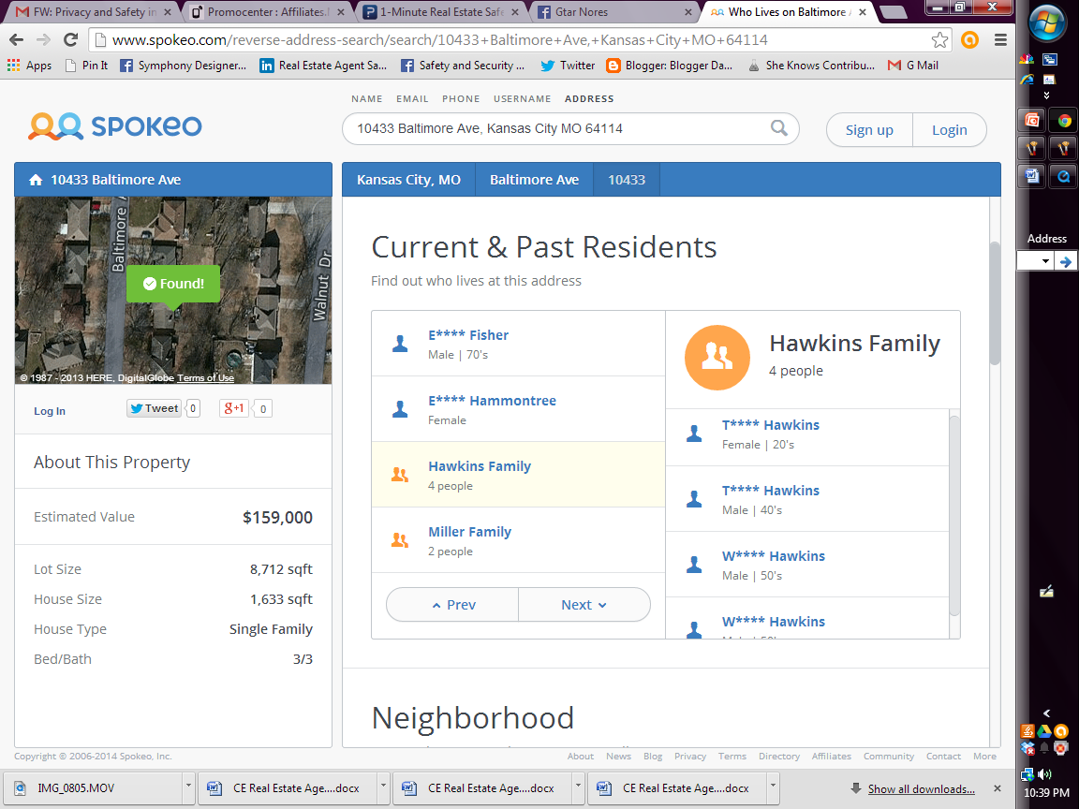
Spokeo.com Address Search

Slide 51
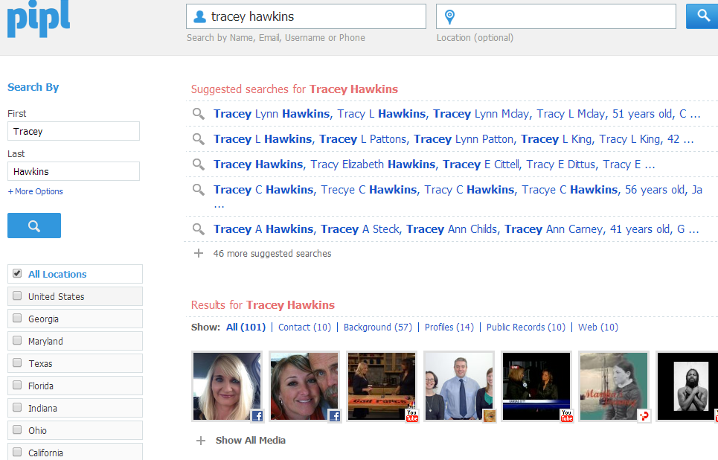
Pipl.com

Slide 52
Research Your Online Reputation

Slide 53
Do Your Research
Know what is in cyberspace about you
Educate your Sellers about this source of personal information
Research your Buyers and Sellers

Slide 54
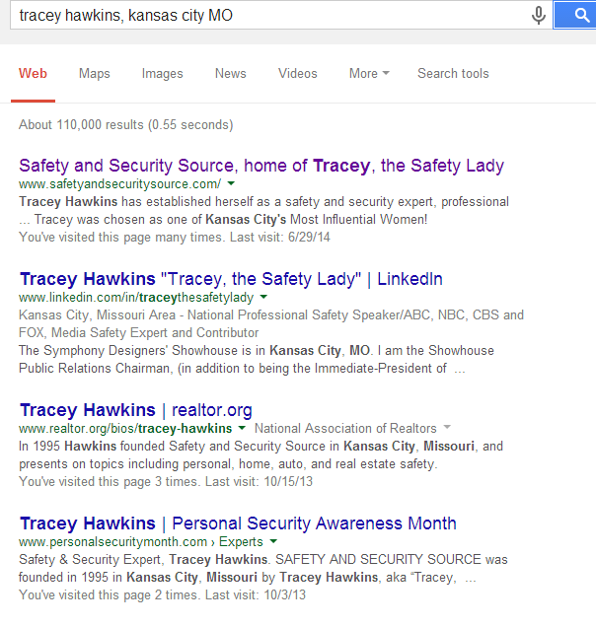
Google Yourself

Slide 55
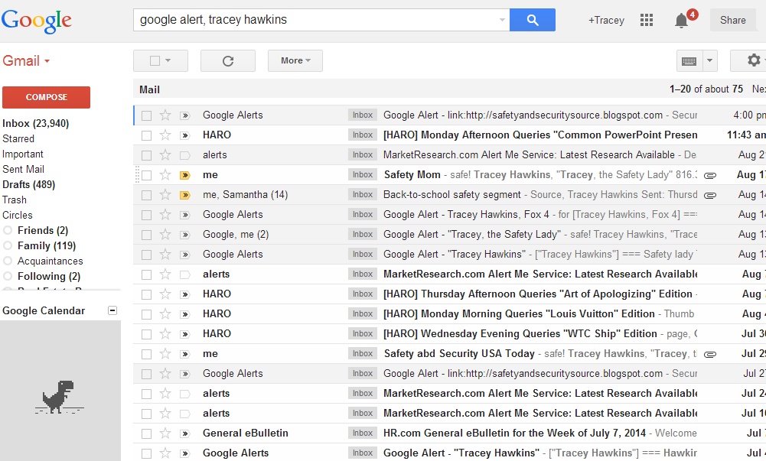
Google Alerts

Slide 56
Manage What Happens to Your Online Accounts After You Die
- Appoint someone as an online executor..
- State in a formal document how you want your profiles and accounts to be handled.
- Understand the privacy policies of each website with which you’re associated.
- Provide your online executor a list of all the websites and login credentials for which you want he or she to take action.
- State in your Will that the online executor should have a copy of your death certificate.

Slide 57
Hack-Proofing Your Smart Phone
Simple step to hack-proof your phone.

Slide 58
What to Look For in a Smart Phone App

Slide 59
MyForce.com
NJRealtor.MyForce.com
Notes:
NJRealtor.MyForce.com

Slide 60
Smart Phone Apps
NJRealtor.MyForce.com

Slide 61
Be a safety and security resource and help protect your Buyers!

Slide 62
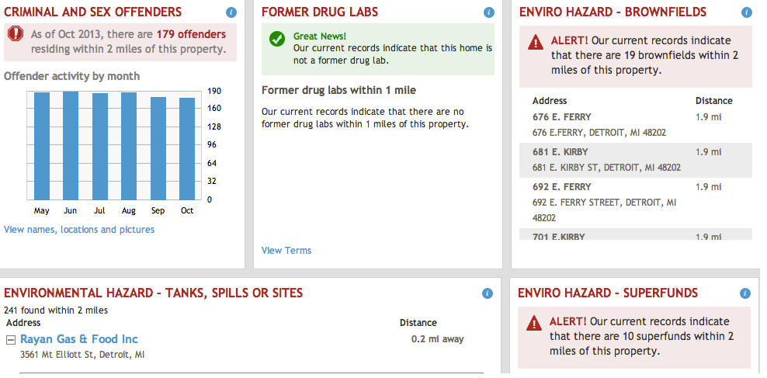
RealtyTrac

Slide 63
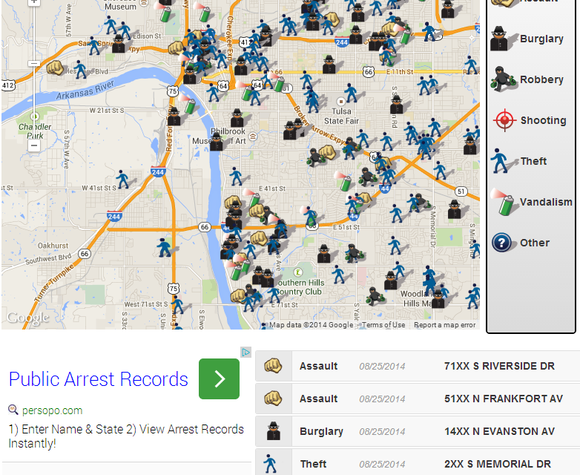
Spotcrime.com

Slide 64
Safety Tools and Products for Real Estate Agents

Slide 65
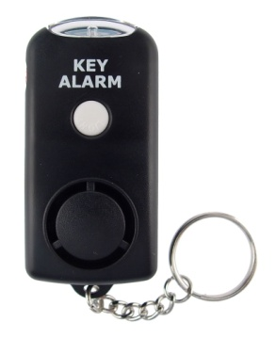
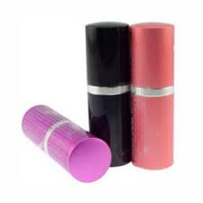
PEPPER SPRAY vs. MACE vs. TEAR GAS
Definitions:
Mace
Tear Gas
Pepper Spray
Which is recommended?
OC (not CN or CS)
2 million Scoville Heat Units (SHUs)
Check the expiration date
Test your spray
Federal crime if used improperly
Notes:
Different sprays then alarm. Products then facts

Slide 66
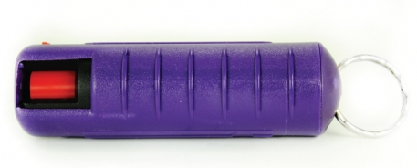
Self Defense Spray Options

Slide 67
Safety and Security Products

Slide 68
Video Safety Tips
Your office can subscribe to receive 2-minute videos of “Tracey, the Safety Lady” with a reminder of real estate agent safety tips.
Share them at your sales meetings on a regular basis.
Ask me about it!

Slide 69
Linked In Group

Slide 70
Safety Designation

Slide 71
Thank You! Tracey Hawkins Real estate agent safety resource- Linked In: “Real Estate Agent Safety Forum” group Twitter: TraceySafeTLady FaceBook: Safety and Security Source www.safetyandsecuritysource.com safetyandsecuritysource@gmail.com
Notes:
I will thank everyone for their time and attention. I will let agents know that if they want to stay in the loop regarding agent safety, crimes against agents and safety solutions, they can join this Linked In group.

